Slide 1
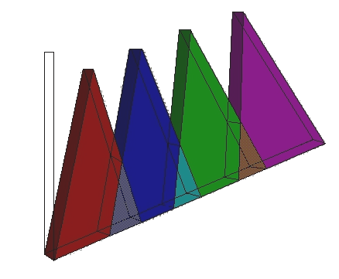
Fuzzy Systems
An Introduction

Slide 2
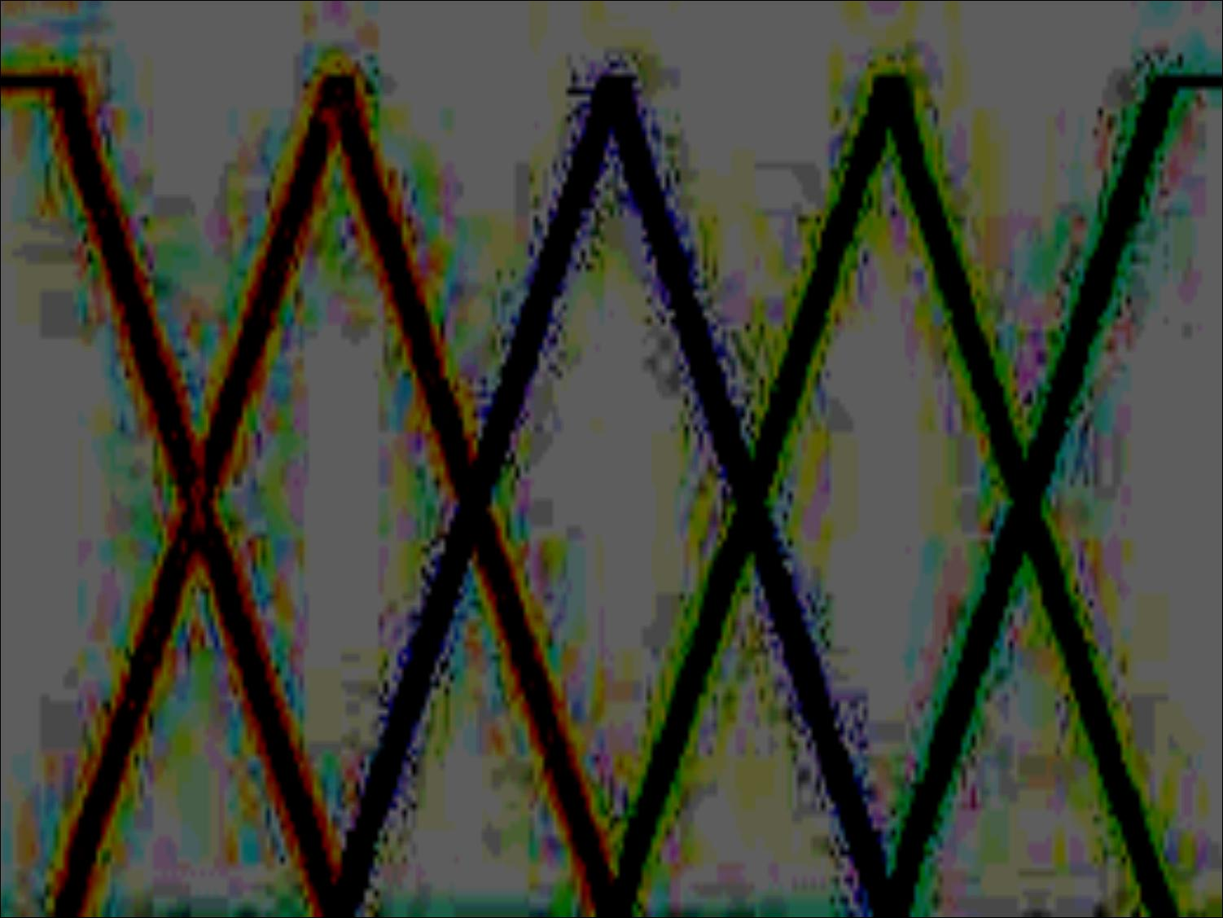
Overview
Need for Fuzzy systems
What are Fuzzy systems?
Foundations of Fuzzy Sets
  Traditional vs Fuzzy Sets
  Fuzzy Membership
Linguistic Variables
Basic Fuzzy Set Operations
Conclusion

Slide 3
Why do we need Fuzzy Systems?
Real world is full of concepts which are vague/imprecise
  Difficult to translate into precise formal/mathematical definitions
  Could be argued that this is disadvantage – but is used successfully
  True/False - “Law-of-the-excluded-middle”
?
FALSE
FTRUE

Slide 4
Why do we need Fuzzy Systems?
Handling real-world vagueness
  Early attempts (c. 1900) included n-valued logic – Łukasiewicz, Knuth etc.
  1965 Lotfi Zadeh proposed the notion of infinite-valued logic = fuzzy sets
  ‘Excluded Middle’ represented as a spectrum of possibility
Don’t know
FALSE
FTRUE

Slide 5
Why do we need Fuzzy Systems?
Provides a means to reason about the ‘excluded middle’
No longer an area of ‘vagueness’ or ‘don’t care’
FALSE
FTRUE

Slide 6
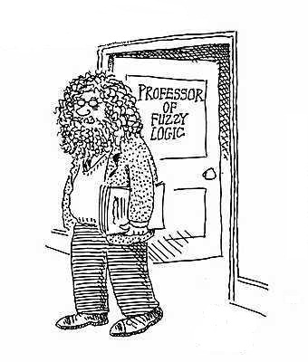
What are Fuzzy Systems?
Based on the foundation of
Fuzzy sets
Fuzzy Sets - to ‘make sense’
of vagueness
Can use human concepts of fuzziness

Slide 7


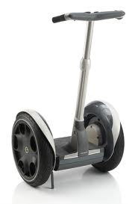
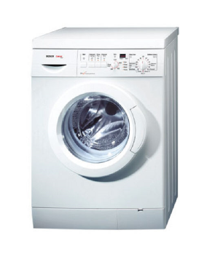


What are Fuzzy Systems?
Lots of applications
  – Control: Sendai Railway, Consumer Electronics, etc
  Expert Systems: Credit card fraud, Production Process Analysis, etc.

Slide 8

Foundations of Fuzzy Sets
The concept of a set is fundamental to mathematics.
However, natural language is also the supreme expression of sets. For example, house indicates the set of houses. When we say a house, we mean one out of the set of houses.
Classic example - concept “tall”. The elements of the fuzzy set “tall” are all people, but their individual membership depends on their height.

Slide 9
Foundations of Fuzzy Sets –
Traditional sets vs Fuzzy sets
Extension of conventional sets:
Conventional Sets - crisp membership: {0,1}
No ‘room’ for partial membership
B
A = {x, z}
B = {y, z}
x , z ∈ A
y , z ∈ B
A ∪ B = { x, y, z }
A ∩ B = { z }
A
x
y
z

Slide 10
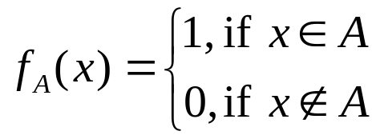
Foundations of Fuzzy Sets –
Traditional sets vs Fuzzy sets
Classical set theory, crisp set A of X is defined as function f_{A}(x) - characteristic function of A:
f_{A}(x) : U → {0, 1}, where
Maps universe U to a set of two elements. For any element x of universe U, characteristic function f_{A}(x) = 1 if x is an element of set A, and f_{A}(x) = 0 if it is not an element of A.

Slide 11
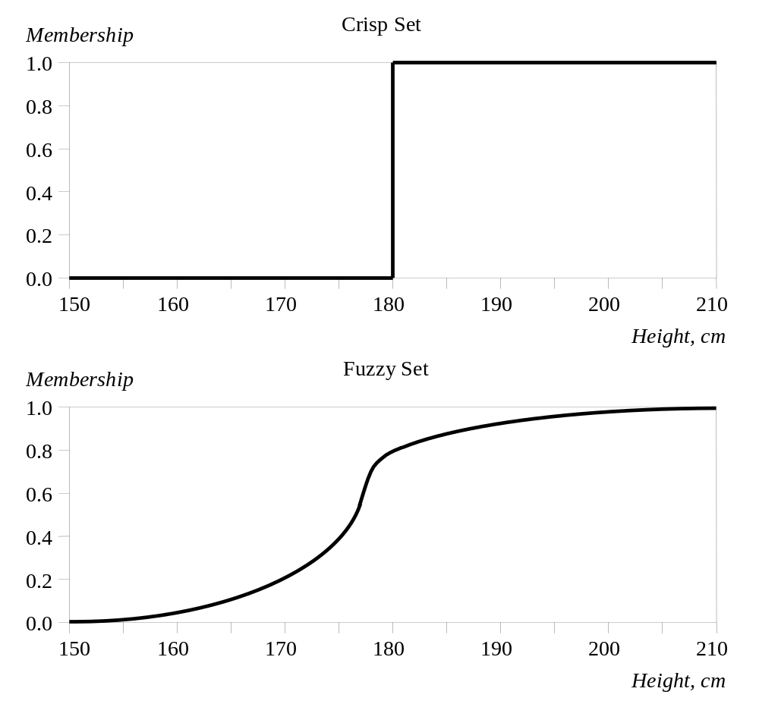
Foundations of Fuzzy Sets –
Traditional sets vs Fuzzy sets
The x-axis represents the universe of discourse – the range of all possible values.
The universe of people’s heights consists of all tall people.
The y-axis represents the membership value of the fuzzy set.
The fuzzy set “tall” maps height values into corresponding membership values.

Slide 12
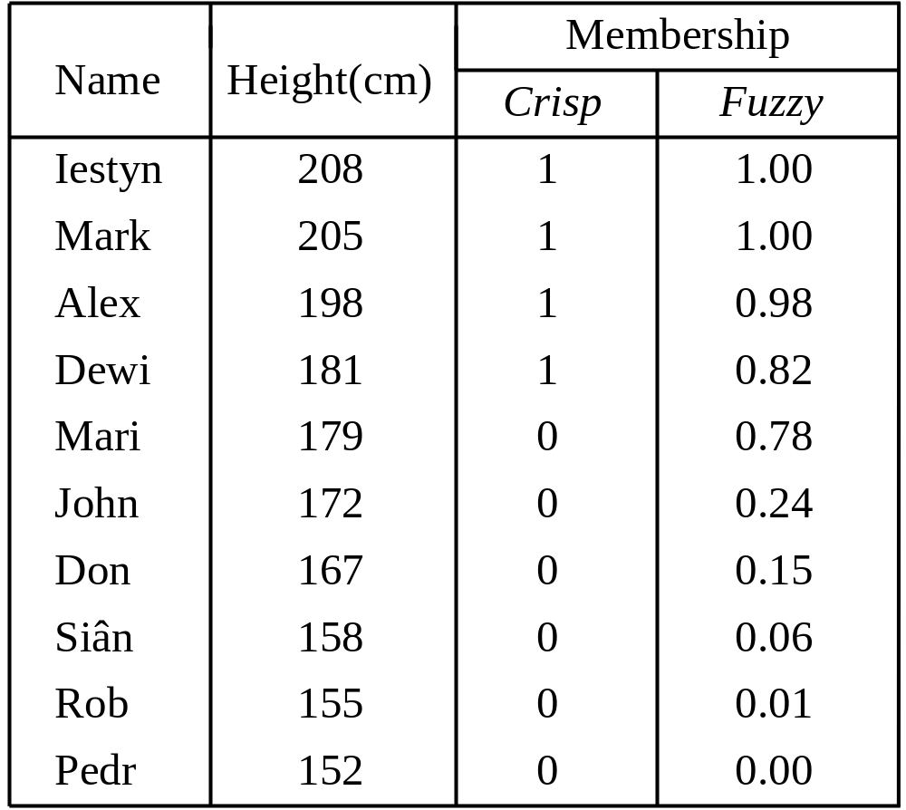
Foundations of Fuzzy Sets –
Traditional sets vs Fuzzy sets

Slide 13
Foundations of Fuzzy Sets –
Traditional sets vs Fuzzy sets
For fuzzy sets: defined by function µ_{A}(x) - the membership function of set A:
µ_{A}(x) : U → {0, 1}, where µ_{A}(x) = 1 if x is completely in A;
µ_{A}(x) = 0 if x is not in A;
0 < µ_{A}(x) < 1 if x is partly in A.
For any element x of universe U, membership function µ_{A}(x) is degree to which x is an element of set A

Slide 14
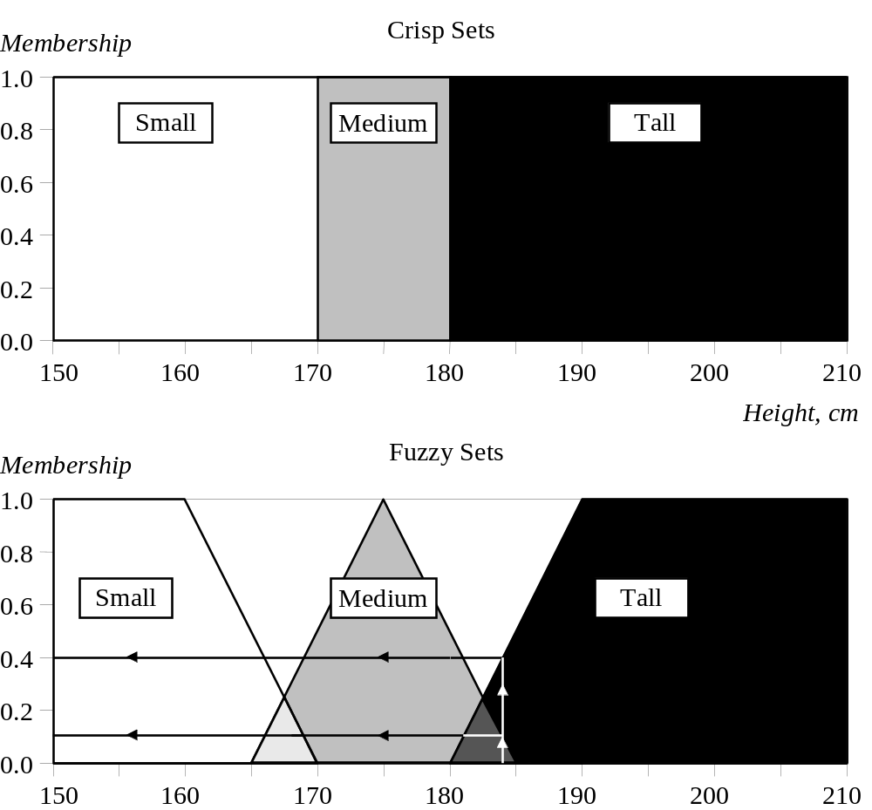
Foundations of Fuzzy Sets
Take the concept of height further - three sets: ‘small’, ‘medium’ and ‘tall’
Person who is 184 cm - a member of the average with a membership of 0.1
However, is also a member of the ‘tall’ set to degree of 0.4.

Slide 15
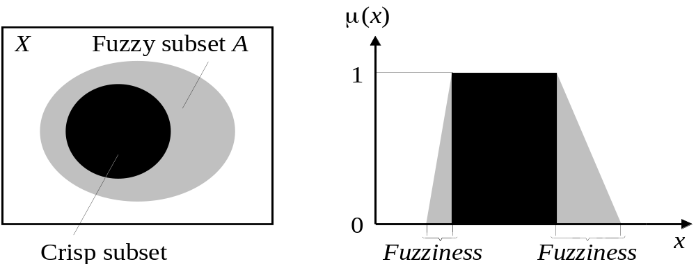
Foundations of Fuzzy Sets –
Fuzzy Membership Functions
Typical functions that are to represent a fuzzy membership functions - gaussian and sigmoid.
High computational cost - most applications employ linear fit functions (trapezoidal)

Slide 16

Linguistic Variables
Central to fuzzy set theory – computing with words
Fuzzy variable - “Alex is tall” implies that the linguistic label/variable Alex takes the linguistic value tall.
Especially useful for fuzzy expert systems
e.g. IF wind is: strong
THEN sailing is: good

Slide 17

Linguistic Variables - Hedges
Range of possible values = the universe of discourse of that variable
For example tall 150cm - 210cm, has fuzzy sets: ‘small’, ‘medium’ and ‘tall’
Linguistic fuzzy set qualifiers, called hedges.
Hedges - modify the shape of fuzzy sets.
Natural language - very, somewhat, quite, more or less, slightly, etc.

Slide 18
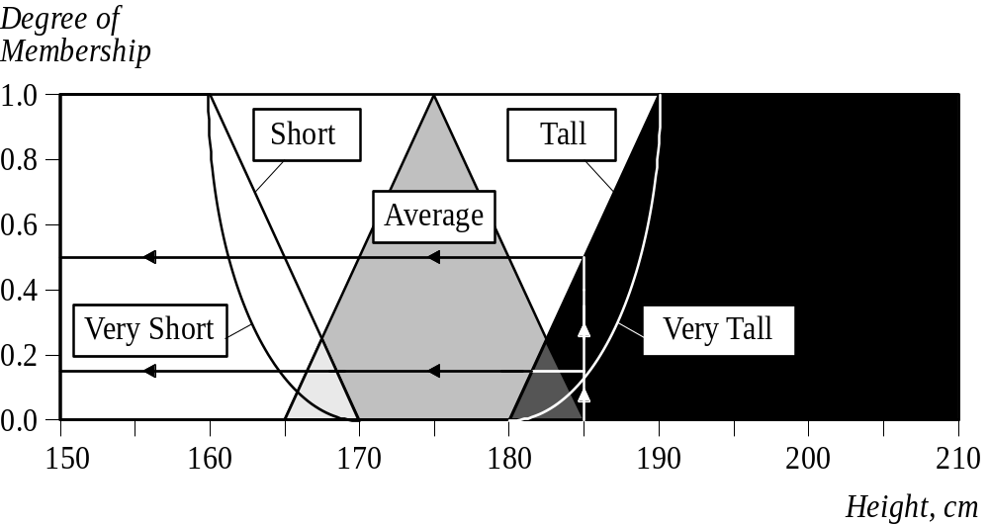
Linguistic Variables - Hedges

Slide 19
Fuzzy Set Operations
Usually a fuzzy set is denoted as:
A = μ_{A}(x_{i})/x_{i} + …………. + μ_{A}(x_{n})/x_{n}
where μ_{A}(x_{i})/x_{i} is a pair “grade of membership” element, that belongs to a finite universe of discourse:
A = {x₁, x₂, .., x_{n}}

Slide 20
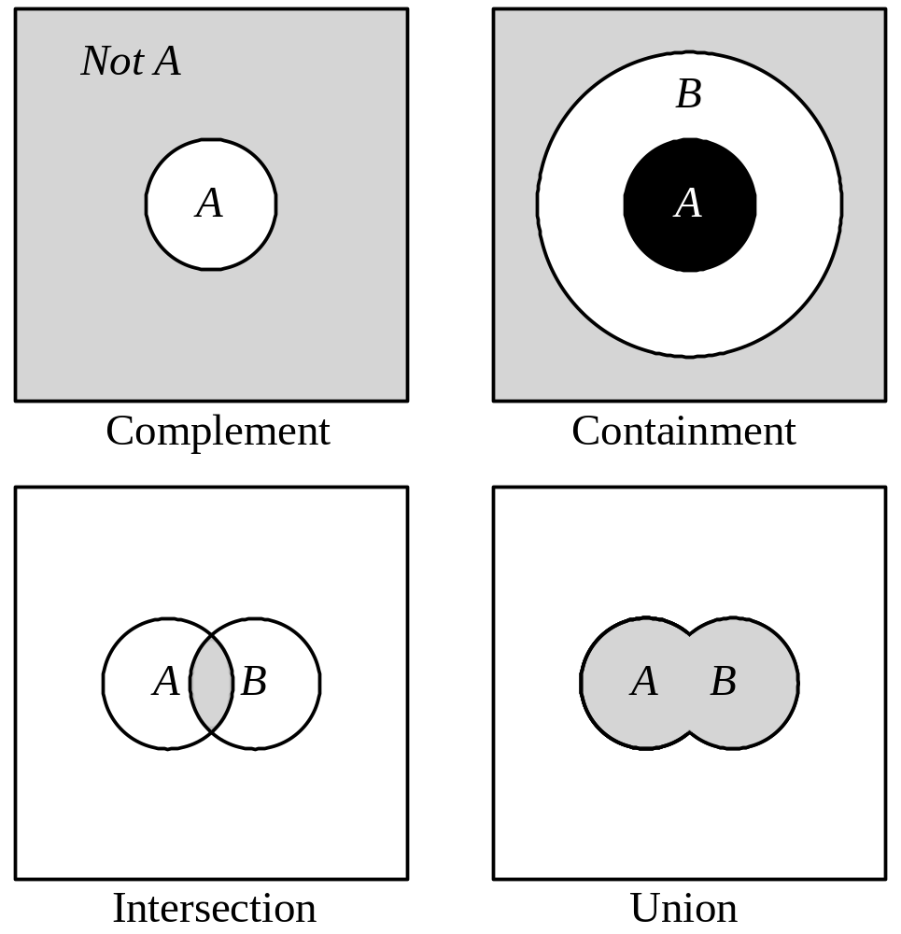
Fuzzy Set Operations

Slide 21
Fuzzy Set Operations - Complement
Classical Sets: Which elements do not belong to the set?
Fuzzy Sets: How much do elements not belong to the set?
The complement of a set – sometimes called inversion.
Earlier example: set of tall people, its complement is the set of NOT tall people.
When we remove the tall people set from the universe = the complement.
If A is the fuzzy set, its complement ¬A can be found:
μ¬_{A}(x) = 1 − μ_{A}(x)

Slide 22

Fuzzy Set Operations - Containment
Classical Sets: Which sets belong to which other sets?
Fuzzy Sets: Which sets belong to other sets?
Russian dolls - a set can contain other sets.
The smaller set is called the subset. For example, the set of tall people contains all tall people; very tall people is a subset of tall men.
However, the tall people set is just a subset of the set of people.
In crisp sets, all elements of a subset entirely belong to a larger set. In fuzzy sets, however, each element can belong less to the subset than to the larger set. Elements of the fuzzy subset have smaller memberships in it than in the larger set.

Slide 23

Fuzzy Set Operations - Intersection
Classical Sets: Which element belongs to both sets?
Fuzzy Sets: How much of the element is in both sets?
Crisp sets - intersection between two sets contains elements shared by these sets – e.g. tall people AND thin people
In fuzzy sets, an element may partly belong to both sets with different memberships.
A fuzzy intersection is the lower membership in both sets of each element. The fuzzy intersection of two fuzzy sets A and B on U:
μ_{A}∩_{B}(x) = min [μ_{A}(x), μ_{B}(x)] = μ_{A}(x) ∩ μ_{B}(x),
where x∈U

Slide 24
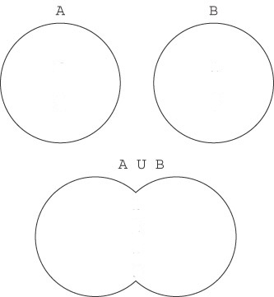
Fuzzy Set Operations - Union
Classical Sets: Which element belongs to either set?
Fuzzy Sets: How much of the element is in either set?
The union of two crisp sets consists of every element that falls into either set. e.g. tall people OR thin people
In fuzzy sets, the union is the reverse of the intersection. That is, the union is the largest membership value of the element in either set.
Fuzzy operation for forming the union of two fuzzy sets A and B on universe U can be given as:
μA∪B(x) = max [μA(x), μB(x)] = μA(x) ∪ μB(x),
where x∈U

Slide 25
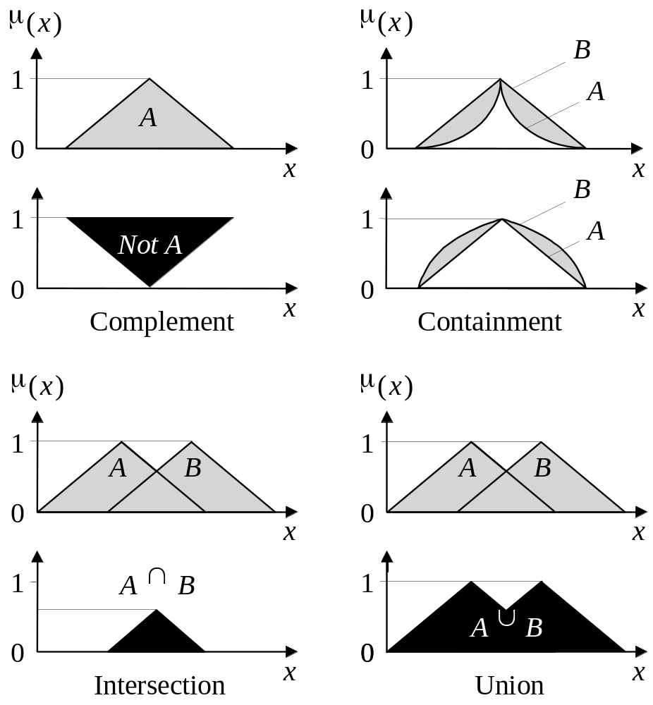
Fuzzy Set Operations

Slide 26
Conclusion
Provide a rich and meaningful addition – excluded middle
FS are a powerful way of reasoning about the vagueness of the real-world
Fuzzy sets are complementary to other forms of reasoning rather than competitive

